Slide 1


DataBase Logic in Business Applications
Al.I. Cuza University of Iași
Faculty of Economics and Business Administration
Department of Accounting, Information Systems
and Statistics
Course outline
By Marin Fotache & Co.

Slide 2
Some bad news
In software development, databases are NOT as important as they used to be
Fifteen-twenty years ago, business apps were developed around databases
Those were DB golden years (DB dictatorship ☺)
Now many devs are DB “agnostics” (often completely ignorants)
Database courses are, in most cases, taught awfully (all over the world) – the main target is database software development (Oracle, MS, IBM) instead of business apps development – see next slides

Slide 3
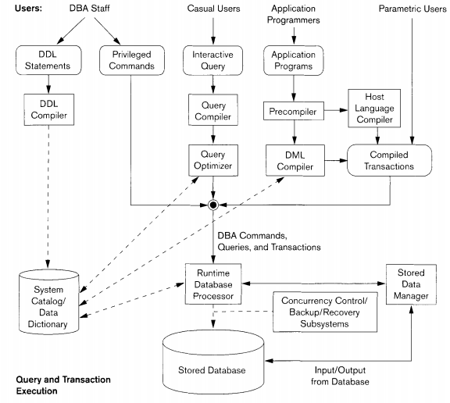
Common DataBase course plan
http://mines.humanoriented.com/403/books/fdbs02.pdf

Slide 4
Consequences of technically-focused DB courses
Students know a lot of details about what’s inside of a DBMS (buffering, caching, logging, …), not much about how to use a database
Mastering mathematical/theoretical issues about database normalization, but insufficient knowledge about how to properly design a database schema
Most of the software developers tend to include all of the application logic (including database query, security, logging) into the application layer (Java, .NET etc.)
There is a chronic poor use of DBMSs features

Slide 5
And now for the good news
Apart from software development, “data-ification” is one of the most vivid phenomena on the IT market (and definitively a buzz)
Databases are part of the data-ification buzz
The broad area of data-ification is usually labelled as Big Data
The main difference between Databases and Big Data is that usually Databases deal with (more) structured/rigorous data, whereas Big Data deals with semi and non (☺) structured data (generated by mobile devices, sensors, web logs, social networks etc..)

Slide 6
Data ramifications & courses at SIA/SDBIS
Databases – dealing mostly with structured data
Logical Database Design: DataBase Logic for Business Applications (DBLBA)
Database query: DBLBA
Database Logic (stored procedures, triggers, scheduler): DBLBA
Physical Database Design (including database optimization) – DataBase Administration (DBA)
Database Administration – DBA
Data Warehouses – dealing also with huge volumes of structured (in some different ways, such as star-schema, snowflake) data
Business Intelligence / Decision Support Systems (BI/DSS)
Data Warehouses, Data Mining and Knowledge Discovery (DWDMKD)

Slide 7
Data ramifications & courses at SIA/SDBIS (cont.)
NoSQL databases – flexible schema (schema-less) and scalable data stores: Polyglot Persistence and Big Data (PPBD)
Document Databases (Mongo)
Columnar Databases (Cassandra, Hbase)
Graph Databases (Neo4j)
Big Data – Hadoop Ecosystems: Polyglot Persistence and Big Data (PPBD)
Hadoop – HDFS, MapReduce, Yarn
Hive
In-memory database systems: Polyglot Persistence and Big Data (PPBD)

Slide 8
Data ramifications & courses at SIA/SDBIS (cont.)
Data Integration:
Information Integration and Web of Data (IIWD)
PPBD
Data Analysis, Data Mining, Data Science
BI/DSS
PPBD
DWDMKD
Information and Knowledge Management (IKM) / Knowledge Management, Analytics and Data Science (KMADS)

Slide 9
DBLBA Course Content (see also Course Description on FEAA portal)
Database fundamentals (recap)
Database Query – SQL (recap + pivot + OLAP)
Basic programming in Oracle PL/SQL
Bloc structure
Procedures
Functions
Cursors, exceptions
Collections in PL/SQL: associative arrays
Persistent collections: SQL for collections in PL/SQL
Packages
Triggers

Slide 10
DBLBA Course Content (cont.)
Logical Database Design
Domains and Types
Entity-Relationship diagrams
Temporal Validity, de-normalization, post-normalization
Common Seed Models and Patterns in Database Modeling
Heterogeneous items (products and services)
Packages of products and services
Metadata
Manufactured products (recipes and manufacturing)
Identifiable products
Standard and customizable configurations
Discounts

Slide 11
DBLBA Course Content (cont.)
Implementing Database Logic using PL/SQL
Managing denormalized/calculated attributes
Sequences
Contexts
Logging
User access control through views and triggers
Implementing Business Rules within Database Logic
Business Rules examples
Business Rules and triggers
Business Rules and schedulers
Some PL/SQL Utilities (Dynamic SQL, ...)

Slide 12
Teaching & Assessment
DBLBA is common to SIA and SDBIS master programmes curricula
The course will be taught in English at SDBIS (with an awful accent ☺) and Romanian at SIA (with another awful accent...)
References will be in both Romanian and English
Main books (Fotache et al. 2003, Fotache 2009) and some video-tutorials are in Romanian
Most video-tutorials are in English (youtube)
For SIA students, DBLBA labs and assessment (homework/tests/project) will be in Romanian
For SDBIS students, DBLBA labs and assessment (homework/tests/project) will be in English

Slide 13
Teaching & Assessment (cont.)
Assessment: one individual (written) test, three ad-hoc team problems and a two-part project
Ad-hoc team problems scenario: each team gets (blindfoldedly) a problem (SQL, PL/SQL, triggers) which must be solved “on site” in a given interval (45 -90 minutes); in many cases scripts for table creation/loading will be available; the lab coordinator will discuss with each team and provide basic help (when solutions get horrible wrong); during the preparation of the solutions, team members are allowed to access the course resources, including internet references (except for messaging, social networks...)
For the two-part project the team will design a database schema (part 1) for which all the database logic will be implemented in Oracle PL/SQL and APEX (part II); teams are free to choose a favorite subject/topic for the database schema and logic
All of the teams will be composed of exactly three students (except for the last team(s)); team members come from the same master programme
Teams will get full access to their unique Google Drive directory; project solution files will be uploaded on this directory until the deadline decided by both assessors and students

Slide 14
Teaching & Assessment (cont.)
In the case of the project parts, each team will choose an interval (usually 15-20 minutes for a project section) for presentation/assessment
Presentation intervals could be placed not only within official timetable, but also after the classes(19:40) and/or other days of the week to be proposed and decided by both assessors and the team members
Usually, for every ad-hoc problem and project part/section, each team receives from the assessors a number of points (e.g. 25 points out of 30); this includes presentation performance; points will be split among team members (by them, according to their supposed contribution)
When necessary (e.g. some of the team members keep mum all the time), the assessor will provide the grades individually, noticing the team members about his decision
It is not necessary that every team member to get a grade greater than 5 for every assessment part; the final grade will be computed using formula stated in the course syllabus

Slide 15
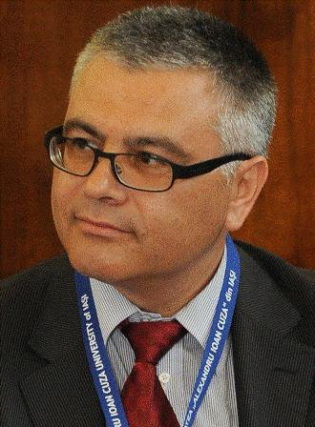





DBLBA/LBDAA Team
Marin
Fotache
FEAA
Cătălin
Strîmbei
FEAA
Kristó Róbert
Synygy
Arezzo Sky
Ionuț
Hrubaru
Optymyze
George
Talabă
Arezzo Sky
Alexandru
Tică
SCCC
Fits
Lucian Lazăr
Optymyze

Slide 16
Additional information about the course
It is (unbearable) dense
Based to a large extent on individual and team work
Assessments are scheduled almost every other week (homeworks, project parts)
Apparently, course/lab attendance is not compulsory; we strongly suggest you to participate and to be involved for a better preparation of test, assessments and project.
Course lectures are dedicated to discussions and case-studies not available (in most of the cases) in references/tutorials
Labs dedicated to real-problems solving, tets preparation, team assessment and feedback

